Slide 1

Speak Fluently & Confidently A2- Course 1

Slide 2
Session 3- Hobbies
Part 1-: Free Activities ( Listening)
Part 2: What would you say in the following
situations? ( More Idioms & collocations)
Part 3: Speaking Practice
https://befluent.me/

Slide 3
Session 3- Hobbies
Part 1-: Free Activities
( Listening )
https://befluent.me/

Slide 4
Session 3- Hobbies
Dai: So, Naomi, so you're from Wales and you're eleven. So what does an eleven-year-old girl do for fun in Wales?
Naomi: I do music. I play the piano and and the violin.
Dai: How long have you played the piano for?
Naomi: Since I was about eight.
Dai: Eight. And what about the violin?
Naomi: About the same?
Dai: OK, and what kind of level are you at now, then, at the piano?
Naomi: I just passed my grade three.
Dai: Oh, congratulations. So that's grade three of ... what is that?
Naomi: Of ... you have different levels.
Dai: OK. And it starts at grade ...?
Naomi: One. And it gets harder.
Dai: Up till ... what's the highest grade you can get?
Naomi: Eight.
https://befluent.me/

Slide 5
Session 3- Hobbies
Dai: Oh, grade eight. So, you're a grade three now. So I guess the next one you're gonna do is grade four?
Naomi: Yeah.
Dai: OK, and so what do you have to do? What kind of test is it?
Naomi: You learn three pieces.
Dai: Three pieces of music.
Naomi: Yeah. And you have to play them and you have do some singing.
Dai: Oh, really?
Naomi: Yeah. And some ...
Dai: Is that like sight reading? You look at the script and you have to sing the notes or ... ?
Naomi: No, somebody plays a tune for you and you have to sing it, exactly the same tune that they played, and there's sight reading where you have to look at the page and then play it on the piano.
https://befluent.me/

Slide 6
Session 3- Hobbies
Dai: Oh, wow. Is that hard?
Naomi: Yeah.
Dai: Yeah. I can imagine. So often ... how much to you practice the piano then?
Naomi: It probably should be once a day, but I normally do it three times a week - about that.
Dai: OK. And you enjoy it then?
Naomi: Yeah.
Dai: OK. Great. And, you play the violin too?
Naomi: Yeah.
Dai: Yeah, is that fun?
Naomi: Sort of. It's not as fun as the piano.
Dai: OK. And do you do any other things in your spare time?
Naomi: I do Guides and swimming.
Dai: Guides?
https://befluent.me/

Slide 7
Session 3- Hobbies
Naomi: Yeah
Dai: What's Guides?
Naomi: It's like a group of girls and they do activities and everything and they meet each week to do activities.
Dai: Like what kind of activities do you do?
Naomi: Well, you can go camping sometimes, and you just do activities like sometimes you do sports and outside activities and lots of things.
Dai: Oh, is it like, kind of like the Cub Scouts for the boys?
Naomi: Yes.
Dai: OK, so you have to wear a uniform?
Naomi: Yes.
Dai: OK, can you explain the uniform for me?
Naomi: It's sort of this dark blue and you can either wear jeans or joggers or these trousers.
https://befluent.me/

Slide 8
Session 3- Hobbies
Dai: Joggers? What are joggers?
Naomi: Trousers that you wear for sports.
Dai: Oh, for like jogging. Oh, OK. well, sounds like you have ... you do a lot of fun things in your spare time.
Naomi: Yeah.
Dai: OK, well, it was very nice to talk to you and good luck with your piano and your violin.
Naomi: Thank you.
https://befluent.me/

Slide 9
Session 3- Hobbies
Vocabulary
play a tune
Somebody plays a tune for you and you have to sing it.
A tune and a song are the same; however, we usually sing a song, but play a tune on a musical instrument. Notice the following:
Why don't you play a tune for us on the guitar?
Our music teacher plays a tune on the piano and we try to copy it.
once
It probably should be once a day, but I normally do it three times a week.
'Once' means the same as 'one time'. Notice the following:
My father does yoga at least once a day.
Most people take a shower once a day, if not more.
https://befluent.me/

Slide 10
Vocabulary
wear a uniform
You have to wear a uniform.
A uniform is a matching set of clothes worn by the same team, students of the same school, or employees of the same company. Notice the following:
The home team usually wears its white uniforms.
My sister hated wearing a school uniform.
joggers
You can either wear jeans or joggers or these trousers.
Joggers are exercise pants. Notice the following:
In America, people call joggers 'sweat pants'.
I usually wear my old joggers to the gym.
Session 3- Hobbies
https://befluent.me/

Slide 11
Session 3- Hobbies
Vocabulary
spare time
You do a lot of fun things in your spare time.
The phrase 'spare time' means the same as 'free time'. Notice the following:
People in prison have a lot of spare time.
If you have some spare time this weekend, you should come over.
https://befluent.me/

Slide 12
Session 3- Hobbies
https://befluent.me/

Slide 13
Answer the following questions about the interview.
7. 1) She has played the piano ____ .
8. a) for three years
b) for eight years
10. 2) What is the highest grade?
11. a) grade 3
b) grade 8
13. 3) What is sight reading?
14. a) an easier way to play
b) a musical test
16. 4) What does she enjoy more?
17. a) the piano
b) the violin
5) What does she do at Guides?
a) outdoor activities
b) swimming
6) What are joggers?
a) sports trousers
b) sports shoes
Session 3- Hobbies
https://befluent.me/

Slide 14
Session 3- Hobbies
Answers:
https://befluent.me/

Slide 15
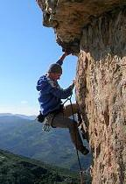

Lesson 4 – Hobbies
Phrases
Here are a few different ways to ask about someone’s hobbies:
"What are your hobbies?" / "Do you have any hobbies?" "What do you do in your spare/free time?"
"What do you like to do for fun?"

Slide 16
“What do you like to do outside of work/school?”
To answer the question, you can say:
“I like… [reading / to read / literature]”
“I love… [painting / to paint / art]”
“I enjoy... [surfing]”
“I’m really into… [photography/chess/gardening]”
“I’m interested in… [astronomy/cooking/computers]”
Be careful not to say “I’m interesting in…” – it’s a very common error!
“I spend a lot of time… [fishing]”
“My newest passion is… [bird watching]”
After “like” and “love,” you can use the “to” form or the “ing” form of the verb (or a noun) – but after “enjoy” and in the other phrases, you can only use a noun or a verb in the –ing form.
For a hobby that you’ve started recently, you can say:
I've been getting into[cooking and baking] lately. I've taken up [sailing].
Most common Hobbies:
Indoor hobbies:
Writing/ baking / cooking
baking is making bread, cake, muffins, cupcakes, cookies, etc. cooking involves all other types of food
collecting cards, coins, art, antiques, stamps, rocks, vintage books/cars/clothing
“vintage” items are those of an old/classic style
sewing / crocheting / knitting

Slide 17
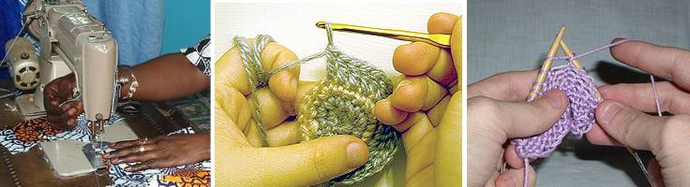
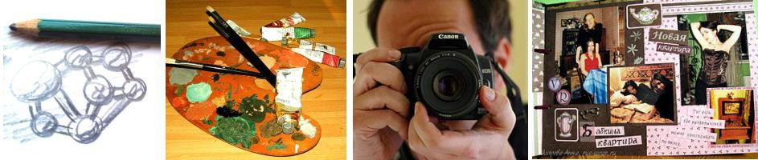
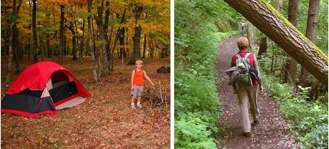
drawing / painting / photography / scrapbooking
“scrapbooking” means arranging photos in a book in an artistic way, with decorations
tinkering with electronics/computers, playing video games woodworking
making things with wood
Outdoor and athletic hobbies:
bird watching camping / hiking
gardening / fishing / hunting

Slide 18

jogging
rock climbing
sailing / surfing / water sports skateboarding
Here are some ways to talk specifically about sports and music:
"Do you play any sports?"
"Yes, I play ___ _."
"I do yoga / martial arts / pilates."
"No, I prefer working out at the gym."
"No, I'm not very athletic."
"No, but I love to watch! I'm a big fan of… [sport / team]."
"Do you play a musical instrument?"
"Yes, I play ___ _."
"I've played the piano for several years."
"I'm taking _ lessons."
"I'm in a band."
"I sing in a choir."
In the dialogue, there are two “follow-up” questions that you can use to ask for more information, after the other person tells you their hobbies:
"How'd you get into that?" (= how did you become interested in it?)
"I read an article / saw a TV show that piqued my interest."
“piqued my interest” = made me interested in learning more
"I took a class."
"I just thought it'd be interesting to try it out."
"My friend introduced me to it (and I've been doing it ever since)."
"

Slide 19
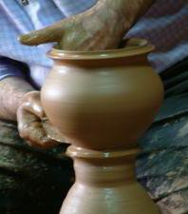
How long have you been doing that?"
"I just started."
"For a few years." (for + time period)
"Since I was a kid." (since + point in the past)
"Ever since I was in college."
- Benefits of Hobbies
Vocabulary & Phrases
What does she has “a lot of time on her hands” mean?
– that means she has a lot of free time with nothing to do.
Here are a few more phrases for talking about present, past, and potential future hobbies:
"I have a lot of time on my hands. I need to find a hobby." "I have a ton of different hobbies."
“a ton of” = a very large number of
"If I had more free time, I'd _______."
use this phrase for an imaginary situation – IF I had more free time, I WOULD…

Slide 20
"I'd like to try ________."
use this phrase to talk about something you are interested in doing, but you haven’t started yet
"I used to _________, but not anymore."
use this phrase to talk about something you did frequently in the past, but you don’t do it now
A couple of different benefits are also mentioned in the dialogue. Here are some different answers to the question of why you enjoy your hobby:
"...because it's a great workout."
= it’s good exercise
"...because it's a great way to relieve stress.” "...because it helps me clear my mind."
= it helps you forget your worries and concerns
"...because it helps me relax." “…because I find it fascinating.”
"...because it's fun/interesting/exciting/(other adjectives)." "...because I can earn a little extra money
on the side."
Now, talk about some hobbies you had in the past, some hobbies you have currently, and one hobby you’d like to try.

Slide 21
Session 3- Hobbies
Part 2: What would you say in the following
situations? ( More Idioms & collocations)
https://befluent.me/

Slide 22
Session 3- Hobbies
To Be Into Something
Meaning: if you’re into something, you’re really enjoying it
Example:
When I was young, I was really into my stamp collection. I took it really seriously.
He is really into his football.
To Take Up
Meaning: to begin, to start a hobby
Example:
👧 I’m bored, nobody to play with, nowhere to go.
👩‍🦳 Why don’t you take up a hobby?
After enjoying taking photographs for a few years, I’ve decided to take up photography as a serious hobby.
To Get Into Something
Meaning: to become interested in something
Example:
Many people decide to take the step to get into running each year.
Many people got into cooking during the lockdown and learnt how to make bread.
https://befluent.me/

Slide 23
Session 3- Hobbies
To Turn Up
Meaning: to arrive for an activity or event
Example:
I turn up in the gym every day, I train hard and I see results.
To Keep Up
Meaning: continue the action that we’ve started
Example:
Previously I have found it difficult to keep up going to the gym.
You have to continue to go to places to keep up your interest in photography.
To keep it up means to keep your interest alive.
To Back Out
Meaning: is the opposite of ‘keep up’, to leave, to withdraw, to lose your interest
You’re not probably too happy with the gym, the equipment is a little bit old. Maybe you don’t get along so much with the people there. So you decide to stop or to back out.
Example:
Running was really not for me so I decided to back out.
https://befluent.me/

Slide 24
Session 3- Hobbies
Part 3: Speaking Practice
https://befluent.me/

Slide 25
Session 3- Hobbies
What is a hobby?
Do you have any hobbies? What are they?
How much free time do you usually have? What do you like to do with your free time? Do you prefer be active?
Do you collect anything? If so, when did you start collecting? How large is your collection?
What kinds of things do people usually collect?
Sometimes, the things that people collect become valuable. Can you think of any examples? What ki gain the most value over time?
Do you like to learn new skills? Can you give an example of something that you have learned to do t related to your work?
Have you attended any classes to help you learn a new hobby? If not, would you like to?
Is there a hobby you are thinking about starting these days? What is it?
https://befluent.me/

Slide 26
Session 3- Hobbies
How long have you had a hobby?
Why do people have hobbies?
Why did you start your hobby?
Can you make money from doing your hobby?
How many hours a week do you spend on your hobby?
Is your hobby safe or dangerous?
What is a hobby?
Why do people need hobbies?
What can one do as a hobby?
How much time can one spend on his/her hobby?
What is your hobby?
Does your hobby interfere with your work/study/personal life?
Do you spend money on your hobby?
Does your hobby influence your choice of friends?
Can a hobby save a child from bad peer influence?
Can a hobby be dangerous?
Have you got a hobby?
How long have you had your hobby?
Which hobbies are the most expensive?
Which hobbies are the cheapest?
Which hobbies cost nothing at all?
https://befluent.me/

Slide 27
Session 3- Hobbies
Which hobbies are the most popular in your country?
Is hunting a hobby or a sport in your country?
Which hobbies are the most popular with women in your country? With men?
Did you have any hobbies when you were a child?
Can you think of any hobbies which are popular with children and adults?
Do you think a hobby is different from a sport?
Are there any hobbies you would like to try?
Are there any dangerous hobbies?
Are there any hobbies you can do in other countries, but not your own?
Which hobbies do you think are the most difficult?
https://befluent.me/

Slide 28
Session 3- Hobbies
Thank you!☺
https://befluent.me/

